Slide 1


Sports & Entertainment Marketing
Management
Minot High School

Slide 2
Section 1
Marketing Basics

Slide 3

Objectives
What is Sports Marketing
Marketing Mix
What is a Sponsorship and Endorsement and how are they different

Slide 4
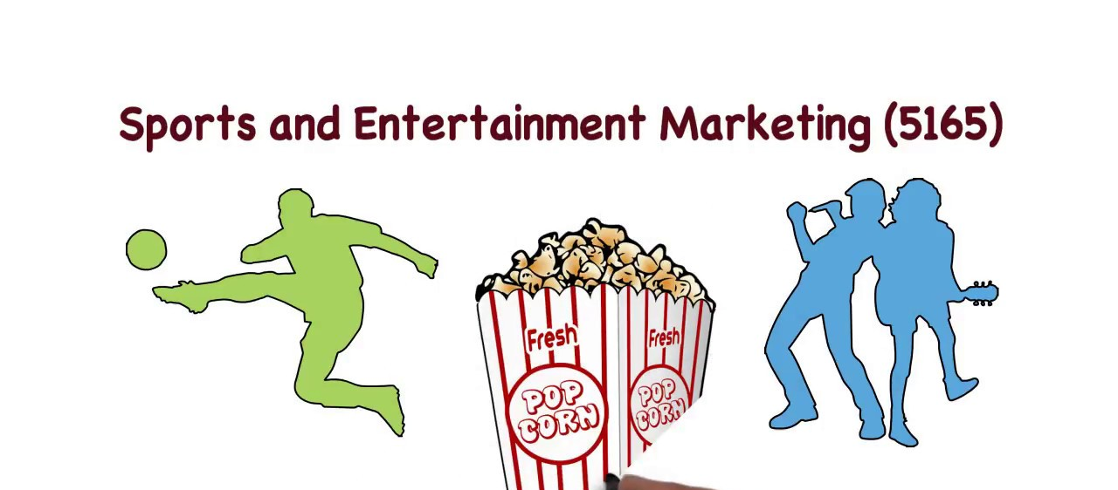
Complete the Web Activity
Page 1 - 3 of your Activity Packet

Slide 5
Discussion from Assignment
What type of jobs are available in Sports & Entertainment Marketing
Sports Agents - find players, Negotiate salaries, and form relationships among other things
Find players in all types of sports, including ice skating, basketball, hockey, football and other sports. Amateur players cannot sign endorsement deals, and Olympic athletes cannot accept money for playing, but those playing at the professional level need an agent capable of getting them the best deals and helping them get exactly what they need. Negotiate salaries, form relationships

Slide 6
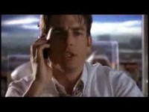
Sports Agent – Jerry Maquire

Slide 7

What is Sports Marketing
Definition: a means of using marketing processes to sell products and services either related or unrelated to sports using sporting events
a subdivision of marketing which focuses on the promotion of sports events, teams, sporting entertainment
promotion of other products and services through these events often arise:
apparel, toys, promotional items, parking, concessions etc.

Slide 8

Primary Focus
Selling the maximum number of tickets and other related items = make a profit
Identify events that customers want
fans identify with their teams and build passion for them
Develop “live” entertainment products that customers consider better than other choices

Slide 9
Value of Sports Marketing
488 BILLION dollar global industry
Why is Sports Marketing Valuable (important)
Large $$$ spent on events and related products
Jobs created: From marketing managers to parking attendants, trainers, concessions workers, security and personal attendants, parking
Local Businesses of Host Cities make millions
Ex: Automobile industry – transport to/from national events and personal kids sporting events
Ex: Restaurants, hotels, service stations

Slide 10
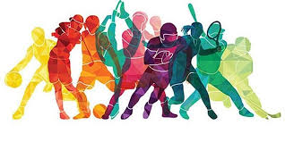
Fun Facts
Generates an average of $400 billion in annual revenue.
64% of Americans watch NFL football
The NFL has $20.4 billion in television deals with CBS, FOX, ABC, and ESPN
18,000 average NBA attendance game
Over 73 million people attended MLB games

Slide 11

Entertainment Marketing
Entertainment = whatever people are willing to spend their money and spare time viewing rather than participating in
Entertainment is viewed in person, in broadcast or recorded form
Movies, theater, music concerts, amusement parks, circus and so forth
Estimated 678 billion U.S. dollars in 2018

Slide 12
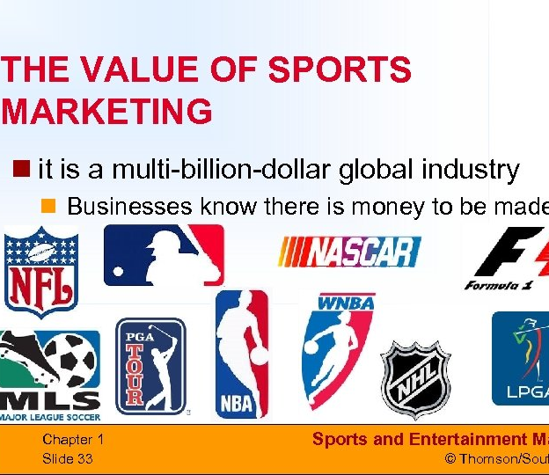
Sport Marketing Industry Value
The sporting market has a sales value of approximately $488 billion
This amount is growing annually by 20%
Entertainment: Estimated 678 billion U.S. dollars in 2018
Annual growth continues

Slide 13
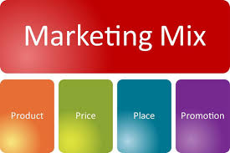
When marketing Sports & Entertainment products, businesses need to create a successful mix of:
The right PRODUCT
Sold at the right PRICE
In the right PLACE
Using the most suitable PROMOTION

Slide 14
Marketing Mix
When developing plans for sports and entertainment, marketers must consider the marketing mix!

Slide 15
Product
Definition: What you are selling
Key components: The brand name, the various products offered under the brand, packaging and any enhancements
Core product: main product (the event)
What is the main product in Sports & Entertainment?
The Event and the ticket for admission to get in
Enhancements: features added to the basic product to satisfy additional needs. ie special seating areas, VIP packages, tiered pricing etc.
Ancillary product: product related to or created from the core product

Slide 16
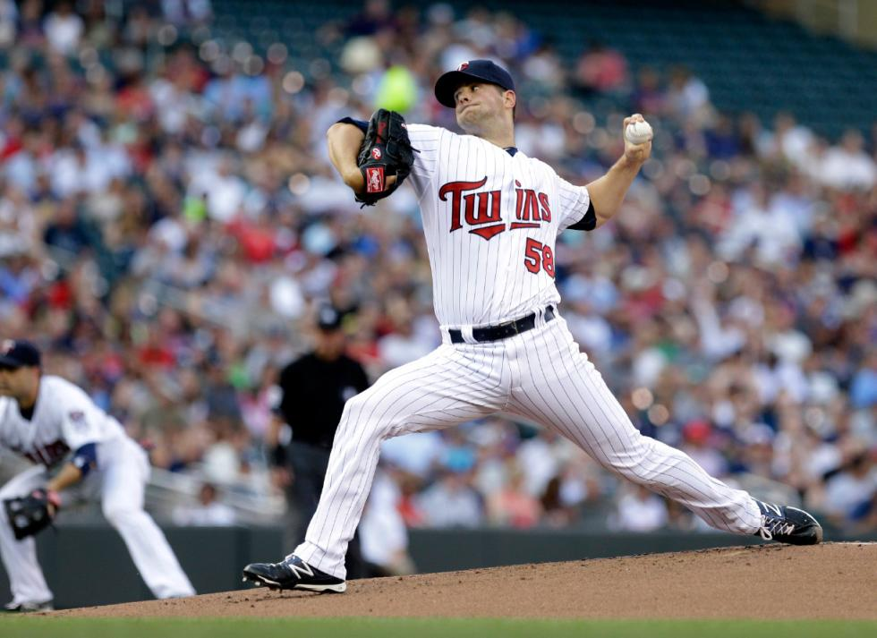
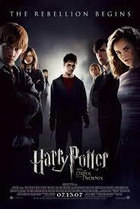
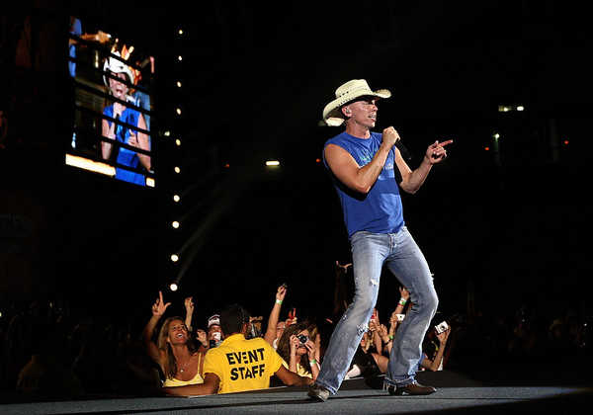
Core product

Slide 17
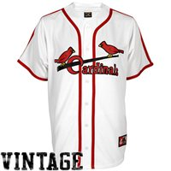
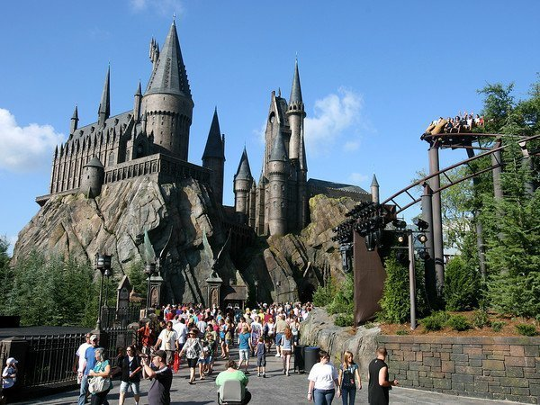
Ancillary product

Slide 18

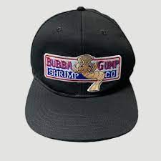
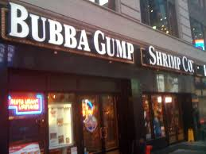
From Forest Gump Movie
What was the core product?
What is the Ancillary Products?

Slide 19
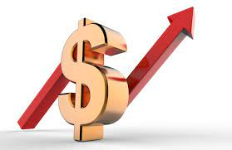
Price
Definition: What sports/entertainment venues charge for products
What people will pay is based on:
National importance of event
Superbowl or Vikings Game?
Popularity of actors/athletes?
Who would you pay top dollar to see?
Rivalry of the contest – Which games for Vikings are more expensive?
How successful is the team
Bundling of products
Where seats are located

Slide 20
Other Items to consider for Revenue Pricing
Tickets
Parking
Concessions
Selling advertising and sponsorship space
Clothing

Slide 21
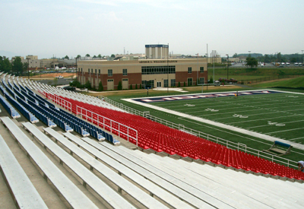
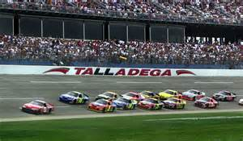
At an NFL football game, which tickets are more expensive?
Up close to the field, or up high
At a concert?
What about at a race track?
Concerts = close to stageRace Track – up high to see the entire track

Slide 22
Complete Group Assignment Part A

Slide 23
Check it Out
Who is the primary competitor of the Cardinals?
Cubs
Lets Compare pricing for the Reds and the Cubs
https://www.mlb.com/cardinals

Slide 24
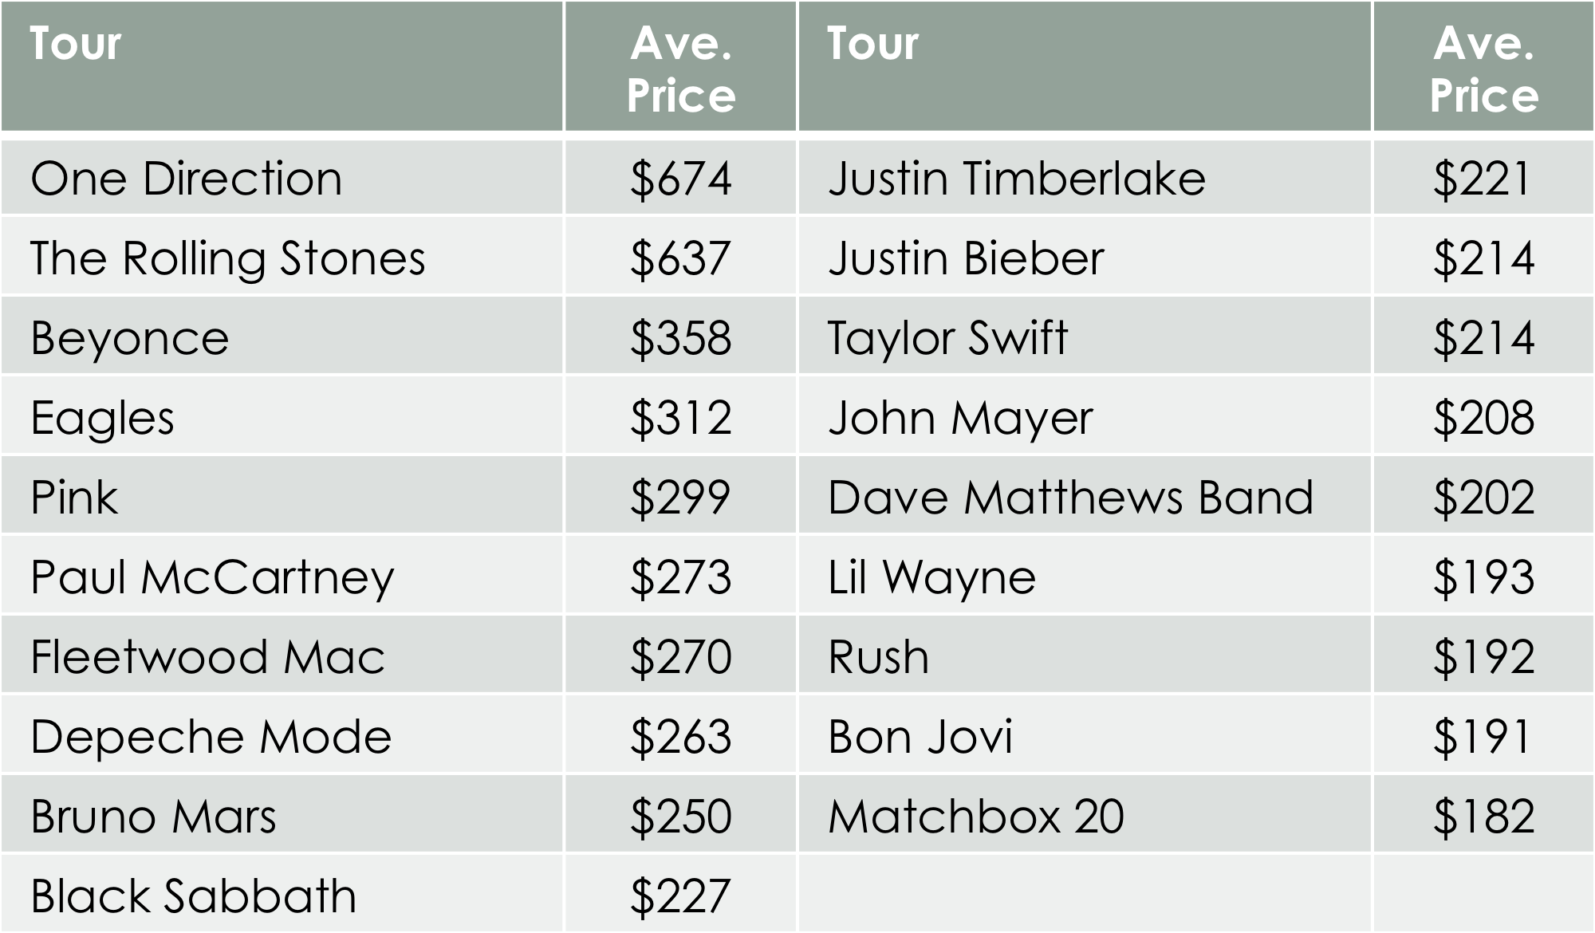

Slide 25
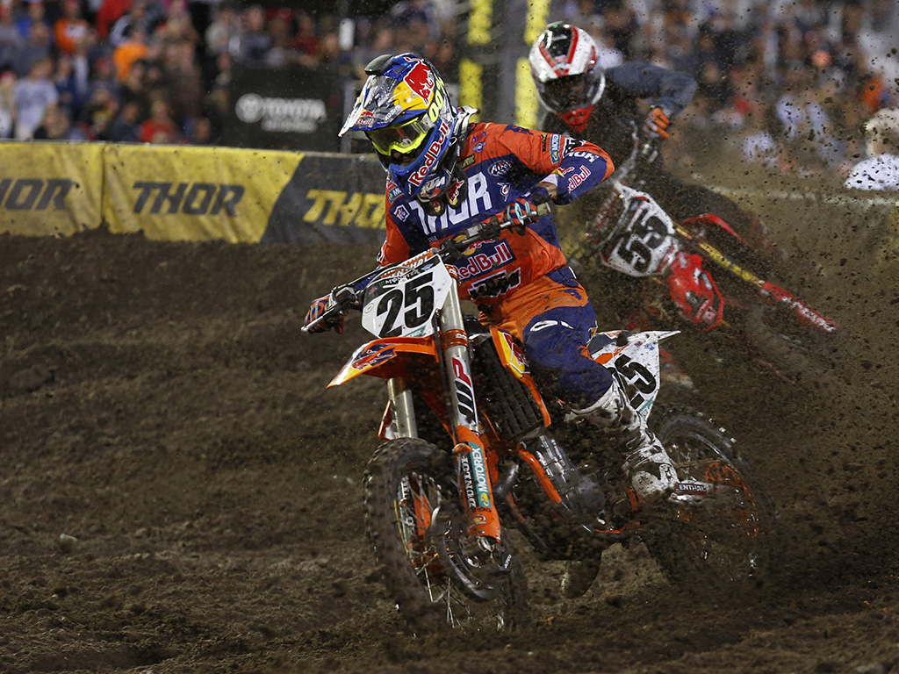
Marketing Mix Place
Place - Event location and distribution of products
Where Ticket sales occur- direct on site, their website, online at vendors (Ticketmaster etc.) included in hotel packages
Distribution: download, physical ticket
Auxiliary products: people go online after an event to purchase related products, booth at events
Bringing in props, stages etc. to make the place the image of the event ex: dirt at Daytona

Slide 26
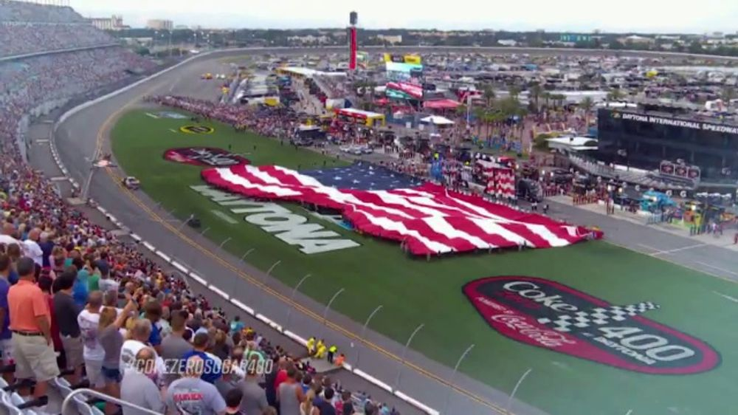
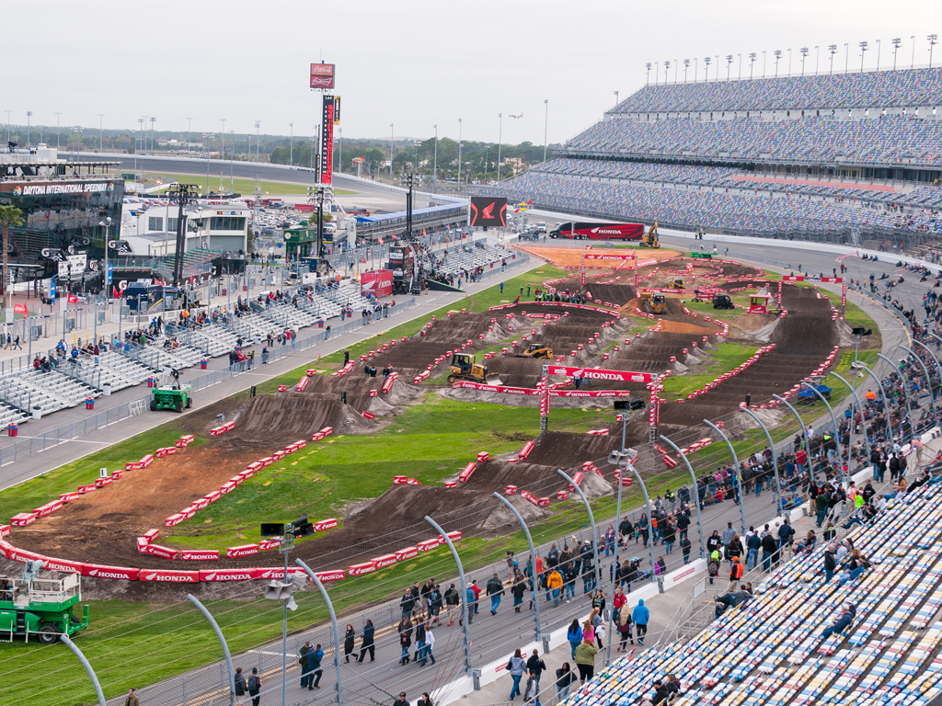
Marketing Mix Place

Slide 27
Marketing Mix Promotion
Promotion: How you communicate your product to your customers
Use a Promotional mix: Television, newspaper, web, and radio ads
Digital Billboards
Emails
Social Media – Yours, community forums, and others
Websites: Yours, your sponsors, and community forums
Endorsements and or Sponsorships
In stadium ads (coupons on back of tickets)

Slide 28
Complete Group Assignment Part B

Slide 29
Endorsement Assignment

Slide 30
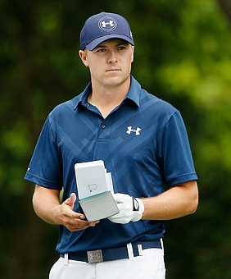
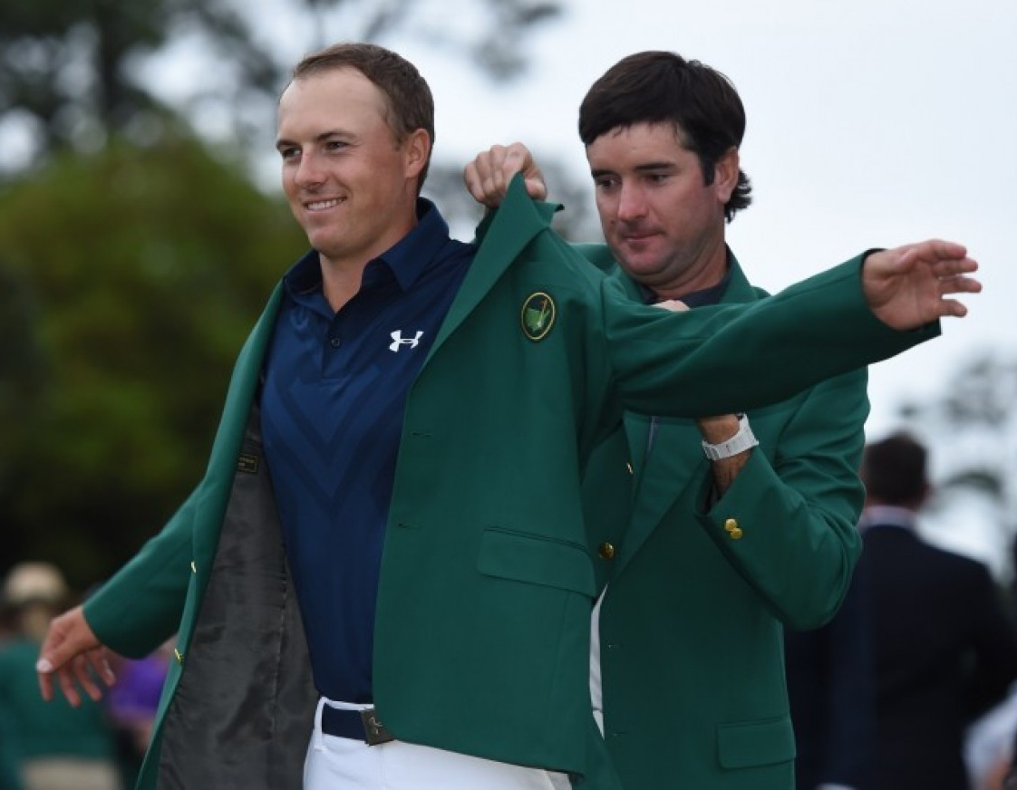
Marketing Mix Promotion
Endorsements: a person’s public expression of approval or support for a product (goods, service, or idea).
usually by a celebrity lending his/her image/name to a product
Paid more in sponsorships than in pay checks
Ex: Jordan Spieth
What product does Spieth Endorse?
How many logos was he wearing during the masters?
Has a contract until 2025

Slide 31
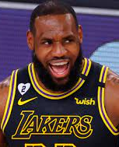
Top Deals in Endorsements
Athlete: Lebron James, Sport: basketball (NBA – Los Angeles Lakers) Brand: Nike Start of endorsement: 2003 (lifetime deal)
Commonly considered one of the greatest athletes to ever grace the NBA and professional sport with his presence. A No. 1 overall draft pick straight out of high school cemented Lebron as the biggest endorsement opportunity since Tiger Woods. Before Lebron even stepped on an NBA court, he had become a millionaire through endorsement offers. At the age of 18, Lebron turned down a $10 million check from Reebok to not meet with Nike and Adidas. The footwear behemoth, Nike soon swooped in on Lebron and in 2015 he resigned for an unheard of
$1 Billion (minimum) lifetime deal one of the largest (if not the largest) Nike endorsement deals in history. Is there any better contract than a Nike lifetime contract?

Slide 32
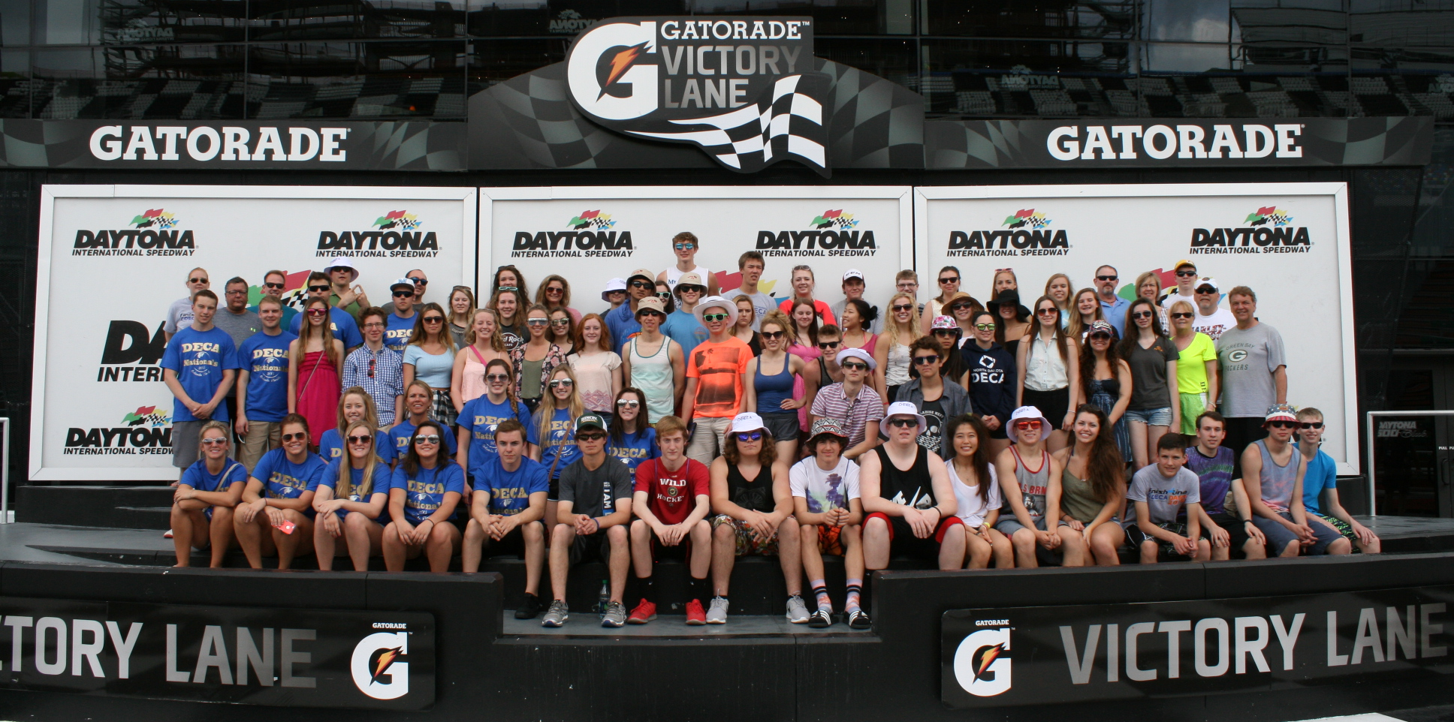
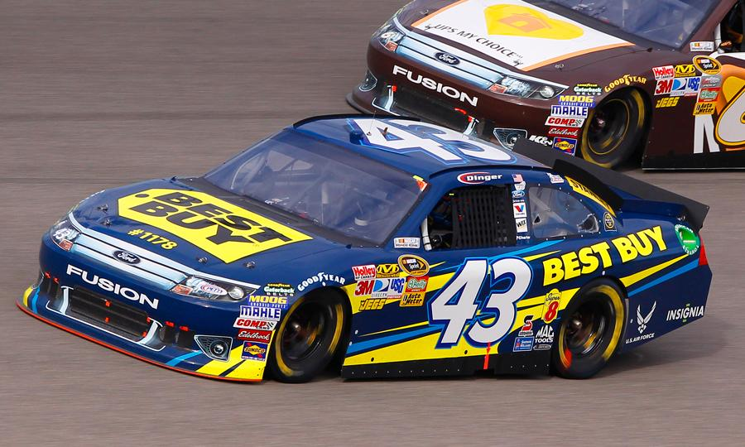
Marketing Mix Promotion
Sponsorships – an organization, or business that gives money or donates products and/or services to another organization or event in exchange for public recognition

Slide 33
Sponsorships
Sponsorship is much more than an outfield sign at a baseball park or a logo on a racecar.
Sponsorship provides, business access, connections, hospitality, audience access, data, and helps to shape public perception
Sponsors gain brand awareness and increased brand preference
Exclusive rights to the event – competitors not allowed
Sponsors may use the images and logo of the partner and call themselves an official sponsor of the property.
Millions are spent on sponsorships

Slide 34
Google Classroom Assignment

